Slide 1
simplerpy
By: Roger Wang, Michelle Hsieh, Regina-Mae Dominguez

Slide 2
Background
rpy2 is a well-known bridging package for Python programmers to use R in Python.
Problem: rpy2’s interface could be confusing to native Python programmers and ML practitioners. It also sometimes displays unnecessary information that detracts from statistical analysis interpretation
Solution: simplerpy
This package, simplerpy, will be building upon rpy2’s interface to make it simpler and easier to use, focusing on functions related to regression and hypothesis testing

Slide 3
Background
Target Users:
Python programmers who would like to run statistical analysis with R in Python
Researchers who use both languages for statistical research purposes
Students who use both languages for their coursework
Data Sources
This package does not require any data. Users may utilize this package on their own datasets for statistical analysis purposes.

Slide 4
Use Cases
1. Perform quick statistical analysis from R in Python:
Utilize this package to gain easy access to running linear models, hypothesis testing, and analysis of variance in Python
Use fit(data) method to fit a model/test and summary() method to get a quick summary similar to the associated model/test summary in R
2. Retrieve details from statistical models and tests:
Call LM.p_value() method for p-values associated with each feature in a linear model
Call tTest.ci() method for the confidence interval for a student T-test
Call AOV.sum_of_squares() method for sum of squares in an analysis of variance model
3. Use R objects directly in Python:
Users who are proficient with package rpy2 will have the option to interact directly with R objects
Users can call r_model_obj() method to obtain the underlying R object for each component
4. Integrate with other Python libraries:
Users can use simplerpy objects with pipeline libraries such as sklearn.pipeline
Text classification with NLTK

Slide 5
Demo
In jupyter notebooks

Slide 6
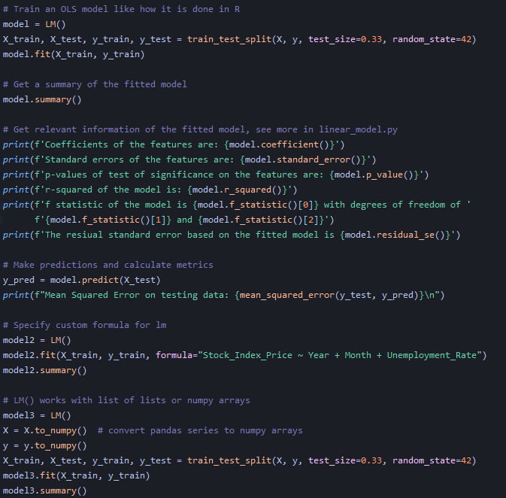
Component 1: LM
Component that fits an linear model model with optional custom formula
Contains methods that return
Estimated coefficients
Standard error of coefficients
Test statistics and p-values of coefficients
Fitted values
Residuals
Degree of freedom
Summary Output
etc.
Makes predictions on new data

Slide 7
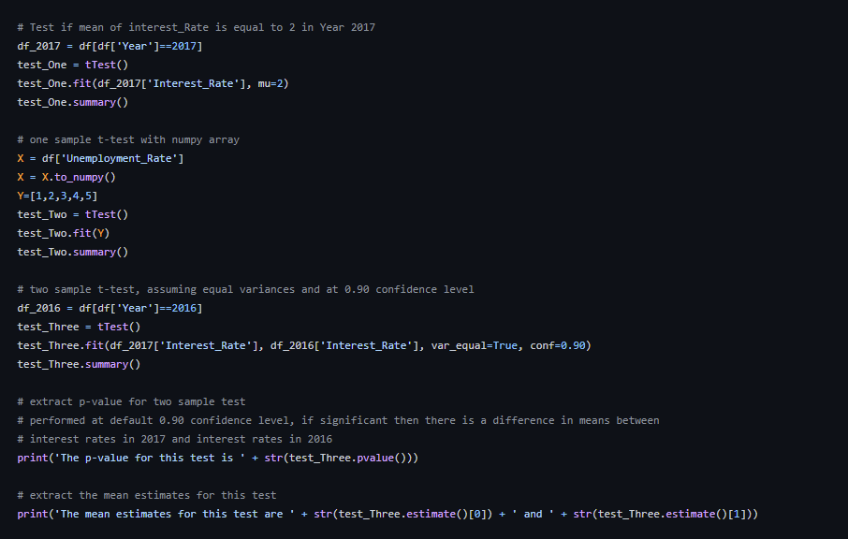
Component 2: tTest
Component that runs a one or two sample student t-test
Contains methods that return
P-value
T statistic
Degrees of freedom
Confidence interval
Estimate of means
Standard error
Method used
Alternative
Summary output

Slide 8
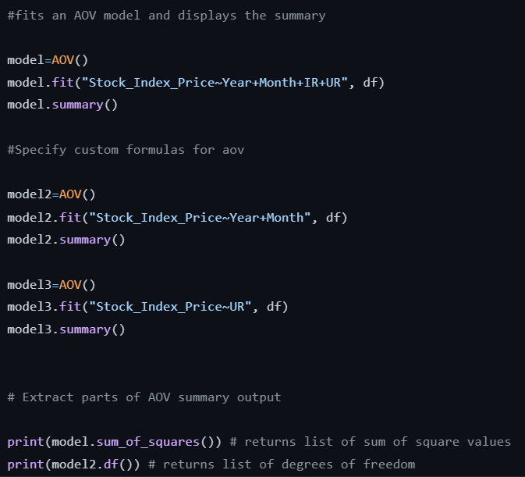
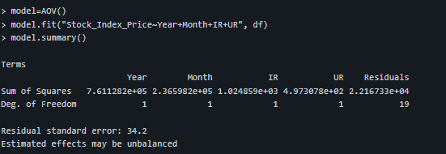
Component 3: AOV
Component that fits an ANOVA model on the specified formula
Contains methods that return
Sum of squares
Residuals
Degrees of freedom
Residual standard error
R model object
Summary output

Slide 9
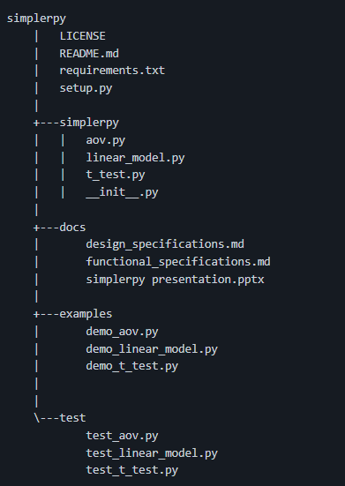
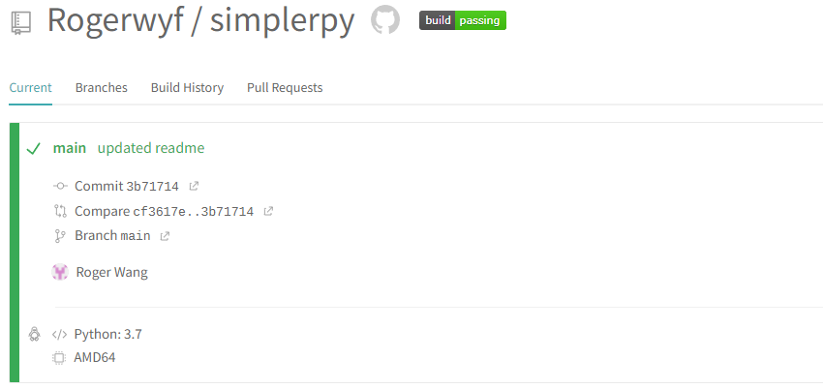
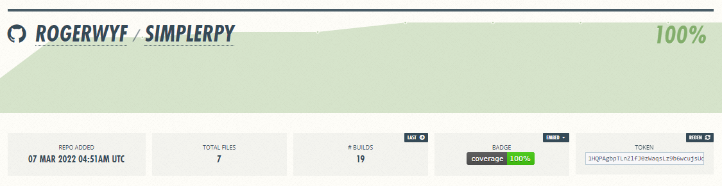
Project Structure and Continuous Integration
Project Structure:
CI via Travis CI:
Test Coverage:

Slide 10
Lessons Learned
Focus on software engineering lessons
Challenges in R objects and rpy2
Class design: attributes vs objects
Notes:
Understanding rpy2 was the first step- a bit confusing and not necessarily user friendly even with going through documentation
Bugs in installing rpy2 but once we got that, working with the r object itself was not inuitive and we wanted to work with its output to clean for easier reading and get rid of the unnecessary output
Class design-deciding between saving values by making it attributes vs just callable through function, however, attributes should be private and not as directly accessible
Saving object: give users the option to interact with the object directly, does not seem necessary to be both

Slide 11
Future Work
Implement more R functions/objects
Generalized linear model
Wilcoxon test
Chi-squared tests
Visualization integration
Histograms
Boxplots
Q-Q plot
Notes:
Our main approach for this project was the concerns of the staticial methods used in Python (scipy stats) is not as up to par as we see it R, in order to further achieve that goal, implementing more functions and objects such as a generalized linear model, the wilcoxon test, chi-squared tests and the ability to use R’s visualization tool for purposes related to exploratory data analysis like histograms, boxplots, q-qplot

Slide 12
Thank you!
Find our project here:
https://github.com/Rogerwyf/simplerpy

